Slide 1
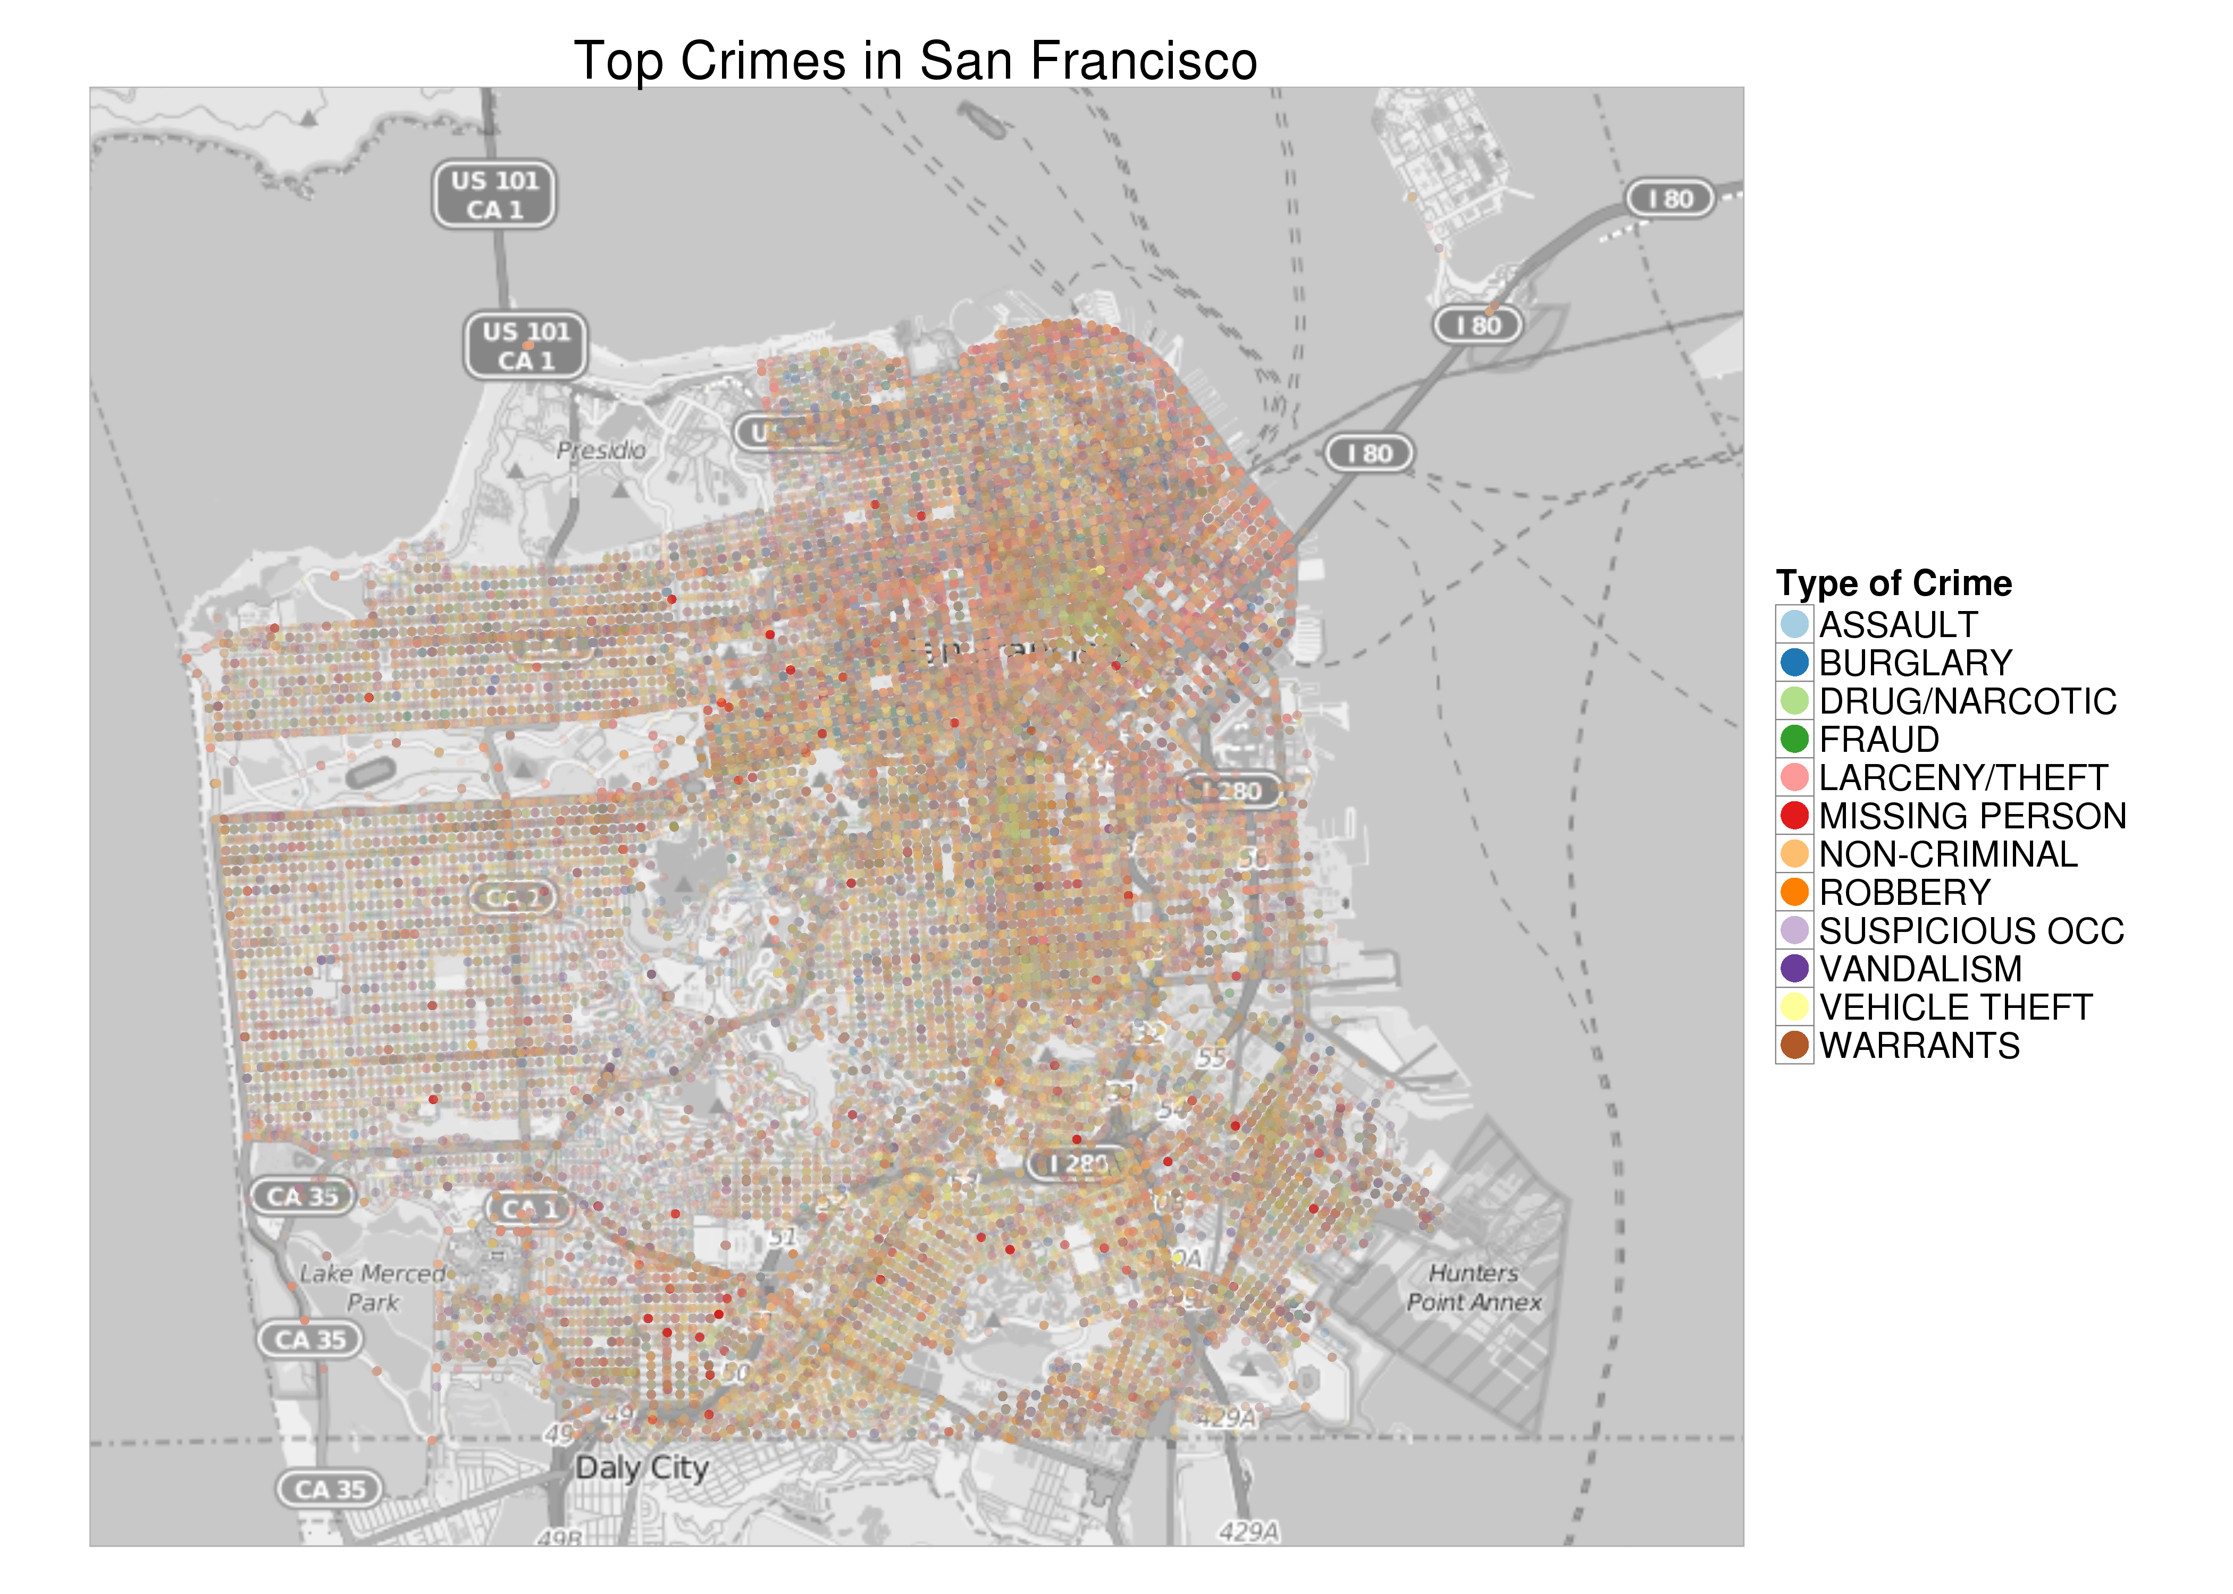
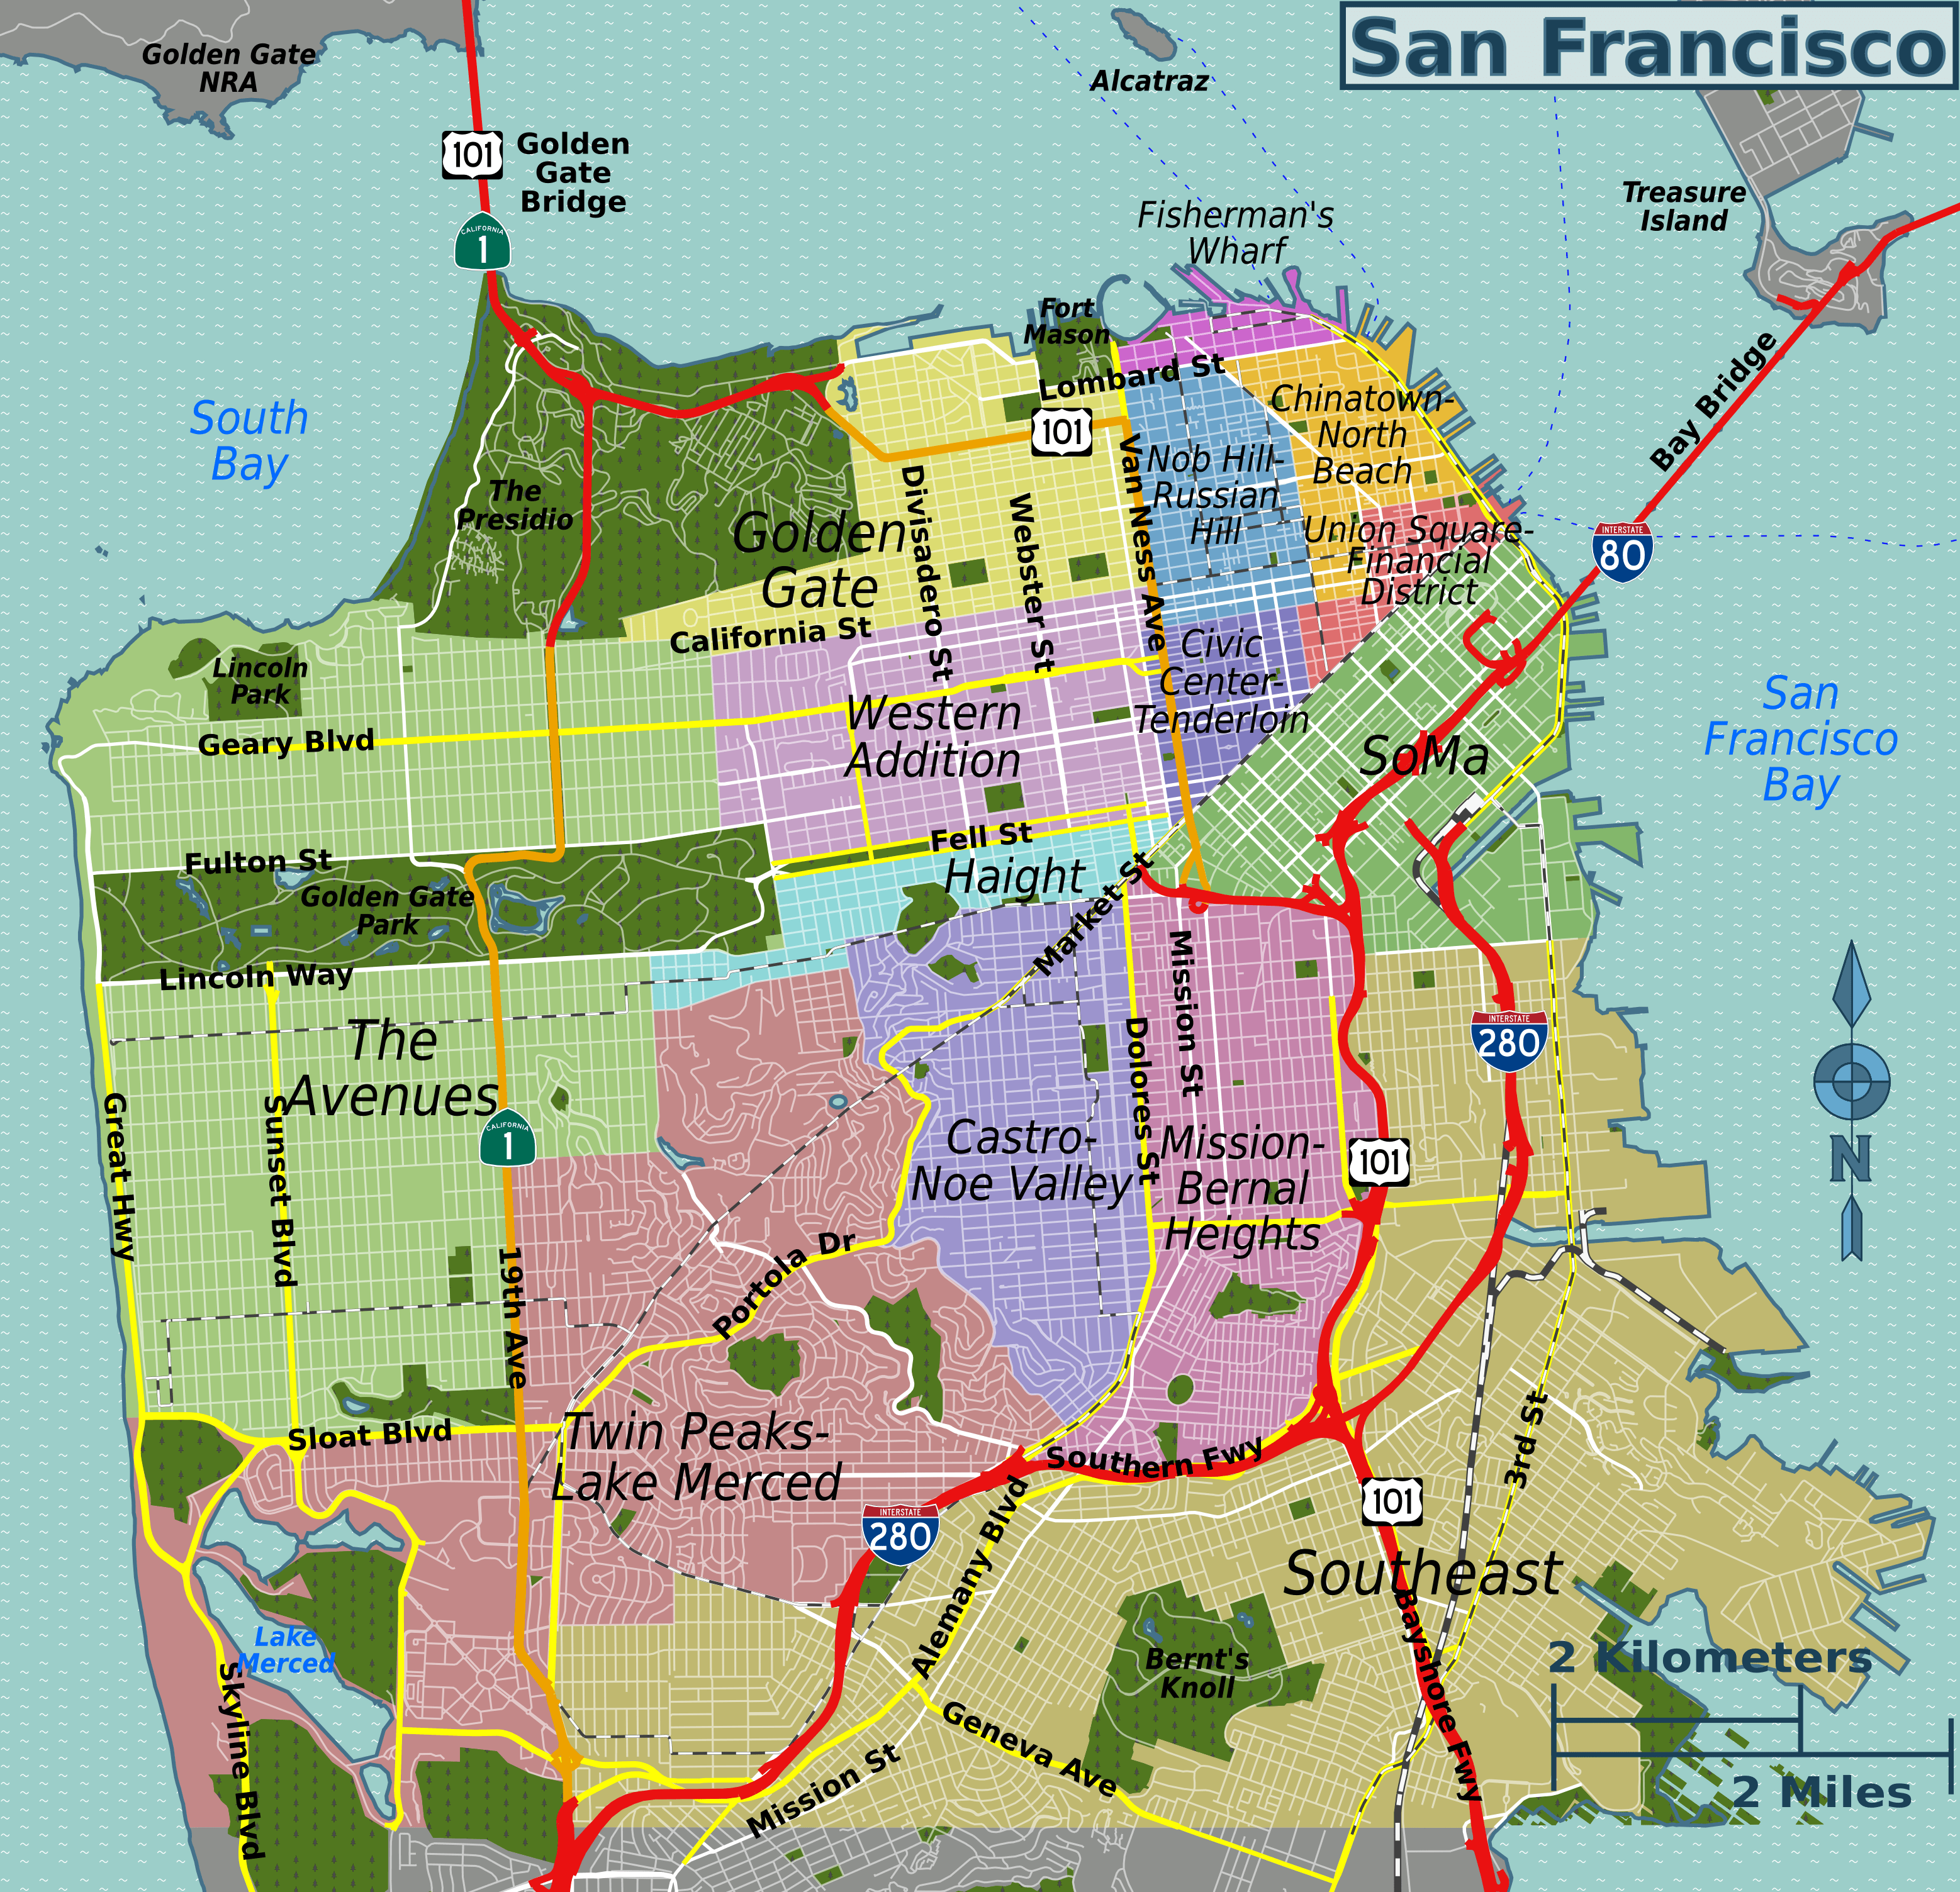
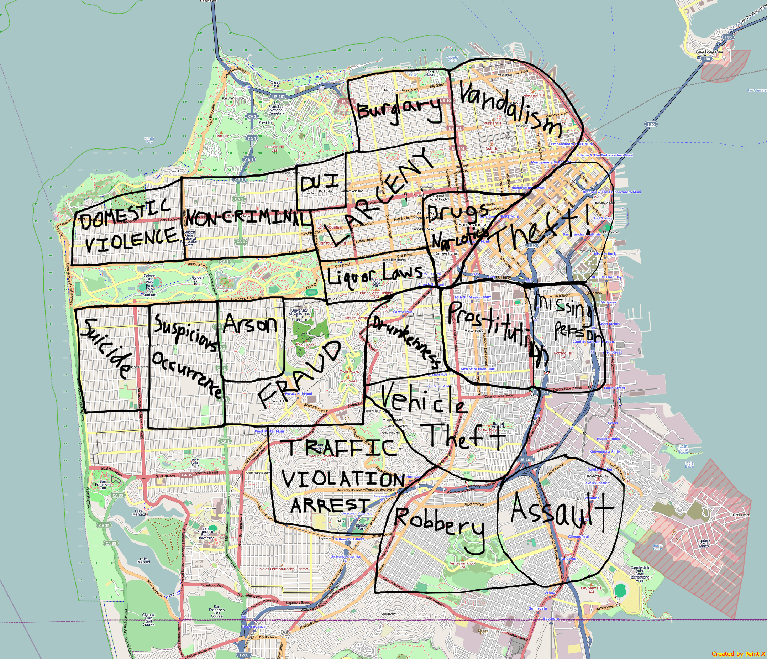
Predicting Crime Category In San Francisco Bay Area
Group Members: Anindita Mozumder James Morgan Nithin Reddy Prashant Sharma Santhosh K Jagadish Srikar Potta Stuti Nanda

Slide 2
Predicting Crime Category In San Francisco Bay Area
Group Members: Anindita Mozumder James Morgan Nithin Reddy Prashant Sharma Santosh K Jagadish Srikar Potta Stuti Nanda

Slide 3
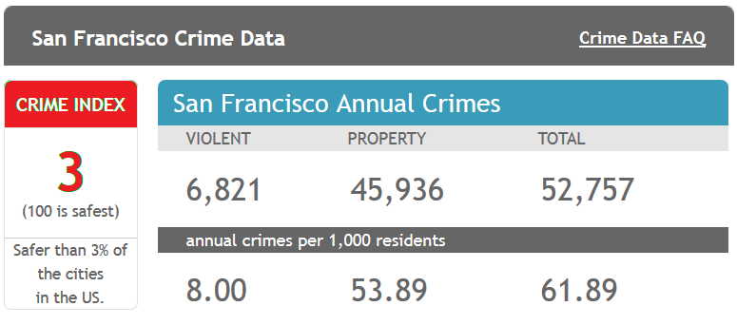
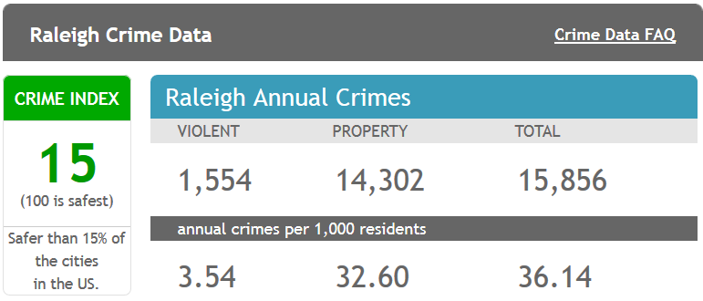
Background
From 1934 to 1963, San Francisco was infamous for housing notorious criminals
Rising wealth inequality, housing shortages responsible for increasing crime rate
The Kaggle’s dataset provides nearly 12 years of crime reports from across all of San Francisco's neighborhoods
Source: http://www.neighborhoodscout.com/ca/san-francisco/crime/

Slide 4

Objective
Given the historical crime data (time and location) predict the category of crime that occurred.
Utilize skills and knowledge gained in CSC522 to
Perform EDA to understand training data
Select and implement set of classification algorithms
Validate and Evaluate classification models
Predict the Crime Category

Slide 5
State of the art

Slide 6
Classification using Meth_Name
Decision Tree
Decision Tree with Bagging
Random Forest
Logistic Regression
SVM

Slide 7
Classification using Meth_Name
Random Forest:
Tuning parameter: Mode
Describe your method(s)
Method we are using along with tuning param
How different it is from state of the art
What is unique about your method
If you have improved a method, how have you improved it?
Have you used any parallel/distributed setup (describe system configuration)
This may change from project to project, so put appropriate materials

Slide 8
Results (max: 2 slides)
Classifier | Accuracy | Methodology | Top Recall | Top Precision | Pros/Cons
Decision Tree | 66.06% | R/Weka | 80.92% | 67.33% | Cons- tree size very big
SVM | 63.09% | R | 75.93% | 65.85%
Neural |  | R |  |  | Cons- very expensive Pro-Better results
Random Forest | 70.833% | R/Weka | 72.37% | 80.40% | Cons- Computationally more expensive. Pros- better results than decision tree
Logistic Regression | 62.37% | R | 77.92% | 40.92%
Decision Tree with Bagging | 65.23% | R | 80.23% | 44.52%
Logistics Regression* | 58.67% | R | 89.68% | 16.19%

Slide 9
Results (max: 2 slides)
Add a graph: accuracy of each of he methods vs time line

Slide 10
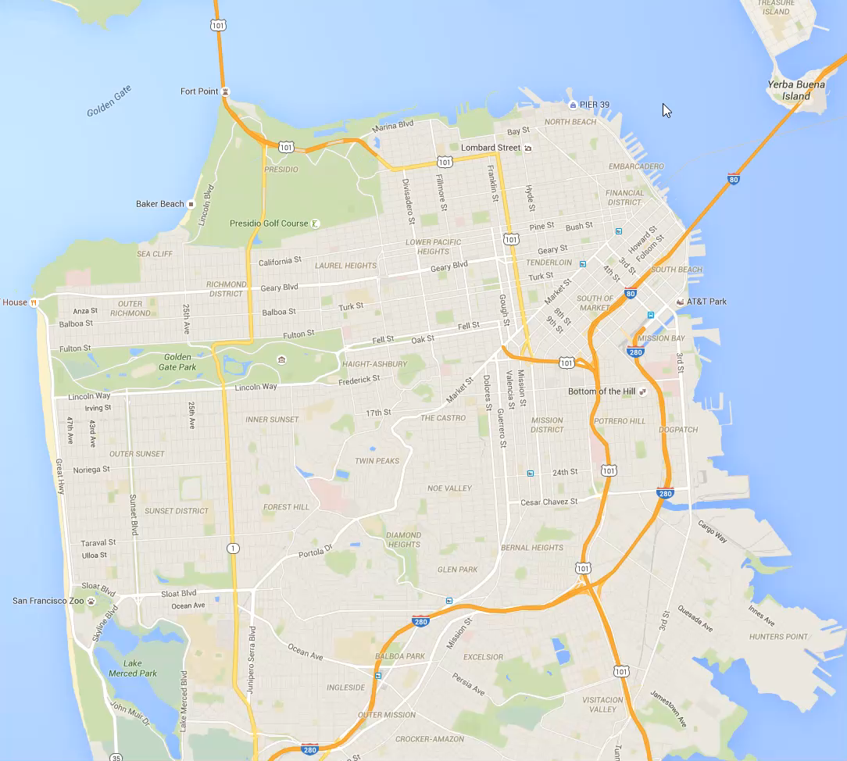
Visualization of Data
-Dataset shown by type of crime, day of week, and surrounding police district
-Visualization aids in understanding data and identifying trends
-Can be used for practical application by end-users (Planning, resource management, etc…)

Slide 11
Conclusions and Future Work (max 1 slide)
What are the conclusions drawn from your method/results?
How can you improve your method further?
Try to tell after doing this work, how your learning goals achieved; and if you have to redo this work, what would you do differently

Slide 12
Remember
Be consistent with fonts, figures, etc. Don’t make font size smaller than 16.
Don’t cram too much details into slides
Don’t go beyond allocated time of 10 minutes.
Try to impress your peers, they are the ones who is going grade your presentation
Every one: use the supplied grading sheet (please note that this activity will considered as class participation and count towards bonus)

